Slide 1


Slide 2
Online job portal (job uae)

Slide 3
Name: Adnan Abbas
Roll No:MCE.IT-11-35
Submitted to:Prof.Adnan Alvi sb
Department of Information Technology
Govt.Emerson College Multan Pakistan.

Slide 4
Table of Contents.
System Analysis
system Design
system Development and implimentation
user Guide

Slide 5
Introduction
Project introduction:
At present, there is a job-crisis and it's very hard to find job for employees. Even if the employees are having good talent, they siffer in finding the right job.Also that is not easy for the recruiters to recruit perfect employees what they exactly want. Some employees are employed, but not at the place where the really should be. so , this job portal helps the employees to find job vacancies in(UAE) appropriately online.
This project has been developed for job seekers and recruiters.It provides a platform to the job seekers to view available jobs and apply for the job of any category and in any field according to their qualification. Job seeker can also subscribe email alerts to receive new job alerts messages. And the job seeker also can search a job of specific category and in specific city of UAE by using search query. Similarly recruiters can also post jobs available in their company and they can see how many candidates apply for their posted job. They can contact them by email or by cell no that candidate has provided in his cv. Recruiters can also update the status of their posted job.

Slide 6
Purpose.
The main theme of this project is to change the manual system to the computerized online system. And also develop a website for job seekers and recruiters just for UAE.

Slide 7
Scope of the Project
The scope of the online job portal includes: The Online job Portal System that is to be developed provides the members with jobs information, online applying for jobs and alert subscription and search job. The basic scope of the project is given as under.
Job Seekers Area
Recruiters Area
Admins panle

Slide 8
Objectives of the Project
The objective of this project is to provide the information about new jobs.
To make our own company of multi services providing to recruiters in UAE.
System will provide a user friendly environment so that any person having the basic knowledge of internet may efficiently apply for a job or post a job add.
Assures the security and safety of data of both members (job seekers & recruiters).
Provide a common platform for job seekers and Recruiters.
Provides a global recruitment centre for job seekers

Slide 9
System Analysis
Need for system analysis
system analyst
Feasibility study
Technical Feasibility
Economic Feasibility
Legal Feasibility
Operational Feasibilty
Schedule Feasibilty
Feasibilty study report.

Slide 10
Description & Drawbacks of existing system:
The existing system is a manual system of limitations like accuracy, expense, low speed and efficiency and unformed outputs. In the existing system, all data processing is done manually. All records are stored in registers. Data is retrieved and search from registers. That is if a company or organization needs employees they make an announcement through newspaper or post ads in different streets and cities. People who are eligible send application to the organization or company. From these applications they are called for interviews or tests. After tests company has to do short listing manually. From these shortlisted candidates, they are called for interviews. After interview short listed candidates are employed. So its all a time consuming procedure. Data is retrieve through registers of selected candidates. And in UAE there are many problems to call job seekers from different countries is a critical task so my aim was that to provide a platform of different companies for providing them labor services on their door.

Slide 11
Description & Drawbacks of existing system:(Conti....)
Recruitment is done manually. These tasks are time consuming. It may take one month or long. People around the world cannot apply. This conventional approach of recruiting people increases the work of maintaining candidates on paper work which requires a lot of manpower. Other than this, it increases the complexity and also contains less efficiency. The automated system needs to be found which replaces the current conventional system or at least decreases this whole process' complexity. It has a huge cost to apply manually because of post charges paper charges and requires more time than online apply. It is hard work to apply manually for any job. Just nearly candidates can apply for that job easily because of test and interview centers.

Slide 12
Description of proposed system
System is aimed at developing a web-based and central recruitment Process system for the Group of companies in UAE. Some features of this system will be creating vacancies, storing application data, and Interview process initiation, Scheduling Interviews, Storing Interview results for the applicant and finally hiring of the applicant. This project Online jobs UAE system is an online website in which jobseekers can register themselves and then apply for any job according to their qualification. After that job seekers will be informed by email or relevant company of that posted job will contact them by their email or their mobile. People all around the world can apply and register. It has made all the process easy.

Slide 13
Tool Selection
Hardware:-
For the development and designing of website we had used better hardware for better functioning of the operating system and faster loading of programs. Hardware required to run this system will be:
Machine Dell Dual core
Processor Intel(R) Core(TM) i3-2370M CPU @ 2.40GHz
RAM 2 GB

Slide 14
Tool Selection
Software:-
Any hardware without software is seemed to be useless in this environment. So different types of software are considered for this specific purpose. Chosen ones are:
Operating System Windows 7
Front end tool HTML, CSS
Back end tool PHP , Java script
Graphic Designing tool Dreamweaver CS6
Database MS SQL
Tools for documentation MS Word

Slide 15
Tools Used for development
Tools and Using Reasons :-
PHP
For making interface and coding.
My SQL
To keep the record of users and their details also for maintaining User personal data for booking request.
MS Word
For ERD diagram, For Use Case diagram ,System Sequence diagram, Sequence diagram.

Slide 16
Tools Used for development
Tools and Using Reasons :-
CSS
For Style.
Java Script
For handle events and form validation.
Dreamweaver CS6
For making interfaces /front –end and admin panel.
HTML
For front end page management.

Slide 17
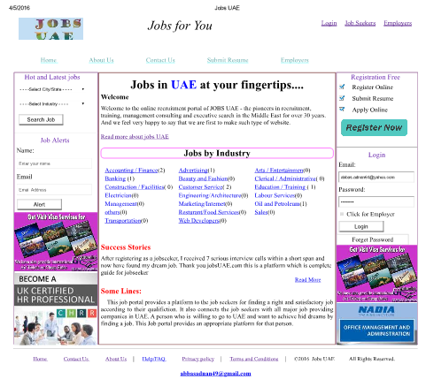
Admin Panel Interface

Slide 18
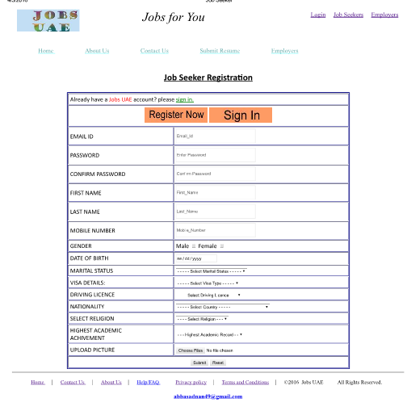
User Interface

Slide 19
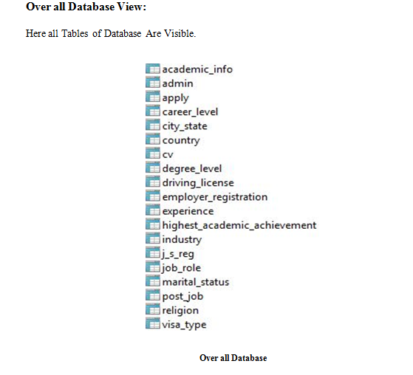
Over all Data Base

Slide 20
Thank you.

